Slide 1


Audiometer and Test Environment
Tri-Service Hearing Technician
4.2 Certification Course

Slide 2
Audiometer and Test Environment
Learning Objectives
1.8.1 Identify the primary types of audiometers used in hearing conservation program
1.8.2 Describe the testing environment conditions for completing audiometric tests
1.8.3 Perform daily checks/tests required prior to testing
1.8.4 Add bio-acoustic simulator (BAS) listener/audiometer into DOEHRS-HC
1.8.5 Establish daily calibration baselines
1.8.6 Identify and troubleshoot audiometric equipment
Tri-Service Hearing Technician 4.2 Certification Course

Slide 3
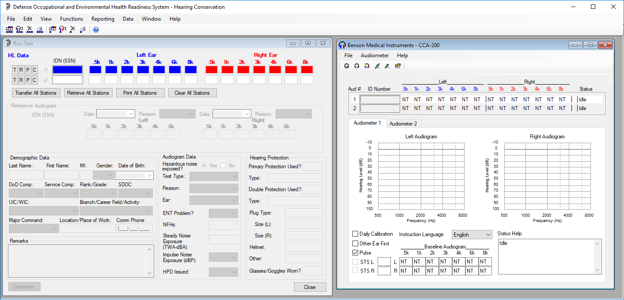
While in training always arrange your DOEHRS-HC desktop as displayed
Notes:
Standardization of students desktop makes it easier for the instructors to visually see that all are students are on the correct window/DOEHRS-HC location. Also some smaller desktop screens may overlap the DOEHRS-HC/CCA-200 window; the tech needs to view the right side of the CCA-200 window for any status problems.

Slide 4
Audiometer and Test Environment
Types of Audiometers
Microprocessor
  Test is computer controlled or automated
  System may have a manual override feature allow user to switch between automated and manual mode
  Manual audiometry competence is required even if a microprocessor audiometer is used
Manual
  Tester is in control
  Not automated
  Can be used for hard-to-test patients
Tri-Service Hearing Technician 4.2 Certification Course
Notes:
Microprocessor: stimuli presentation are created/presented by patient previous responses
Manual: stimuli presentation are created/presented by examiners discretion

Slide 5
Audiometer and Test Environment
Audiometer Specifications
Must meet ANSI S3.6 – current edition
  Specifies range of output for each audiometric test frequency
Earphones and cushions must also comply
Earphones are not interchangeable between audiometers
  Calibrated and repaired as a unit (audiometer/headset)
  Never separate earphones from their audiometer to test patients
Tri-Service Hearing Technician 4.2 Certification Course

Slide 6
Audiometer and Test Environment
Audiometer Acoustical Calibration Check
OSHA requires annually or if equipment fails daily biological calibration
Audiometer output is not adjusted
Performed by trained personnel with appropriate sound level equipment
Audiometer and headphones are calibrated together as a unit
DoD completes exhaustive calibration annually vs. acoustic calibration check
  Conducted by Navy Marine Corps Public Health Center (NMCPHC)
Tri-Service Hearing Technician 4.2 Certification Course

Slide 7
Audiometer and Test Environment
Audiometer Exhaustive Calibration
Electro-acoustic calibration
  DOD has an annual requirement
  OSHA requirement is every 2 years
Audiometer calibrated to ANSI S3.6 current edition
Audiometer calibrated to specific earphones
Audiometer and earphones must have the same serial number
Never test patients with mismatched audiometer headphones
Performed by trained personnel with appropriate equipment
Tri-Service Hearing Technician 4.2 Certification Course
Notes:
NMCPHC does all DOD CCA-200m audiometer calibrations at no charge

Slide 8
Audiometer and Test Environment
Audiometer Daily Calibration and Functional Check
Calibration and functional check required daily prior to any daily audiometric testing occurring
Audiometer and headphones are calibrated together as a unit
If audiometer does not pass daily calibration or functional check, the audiometer cannot be used and must be turned in for repair
Tri-Service Hearing Technician 4.2 Certification Course

Slide 9
Audiometer and Test Environment
Microprocessor Audiometer Advantages/Disadvantages
Advantages
  Built-in calibration and functional check procedures
  Can perform multiple hearing tests at the same time
  Reduces human error
Disadvantages
  More expensive than manual audiometers
  Difficult for some employees
Tri-Service Hearing Technician 4.2 Certification Course

Slide 10
Audiometer and Test Environment
Manual Audiometer Advantages/Disadvantages
Advantages
  Greater examiner control
  Allows retest of one or more frequencies
  Accommodates subjects with tinnitus
  Least expensive
  One-on-one testing
  Best method for hard-to-test employees
Disadvantages
  Can only test one at a time
  Examiner fatigue/error
Tri-Service Hearing Technician 4.2 Certification Course

Slide 11
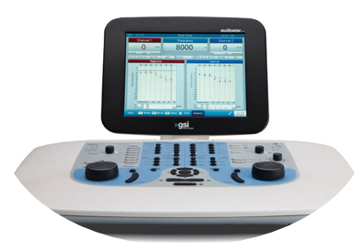
Audiometer and Test Environment
When Manual Audiometry is Appropriate
Use to retest questionable thresholds or when threshold determination is unsuccessful in automatic mode
Subject has difficulty understanding instructions
Motor skill challenges (hand switch)
Distraction, lack of focus, sleepiness
Fear, nervousness
Tinnitus
Tri-Service Hearing Technician 4.2 Certification Course
Notes:
Technicians have the ability to manually test using the Benson Medical CCA-200 window within DOEHRS-HC, discussed in later classes

Slide 12
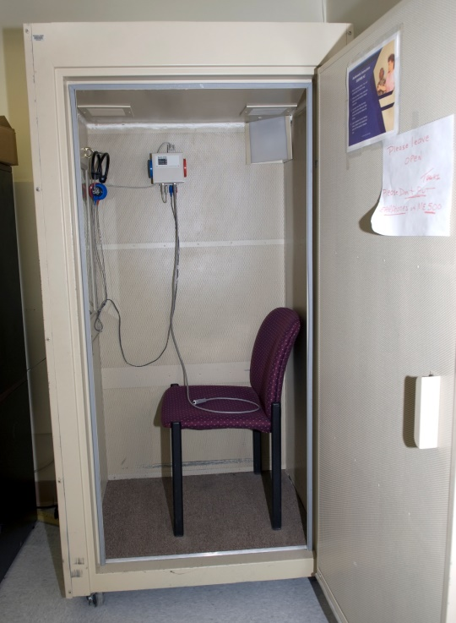
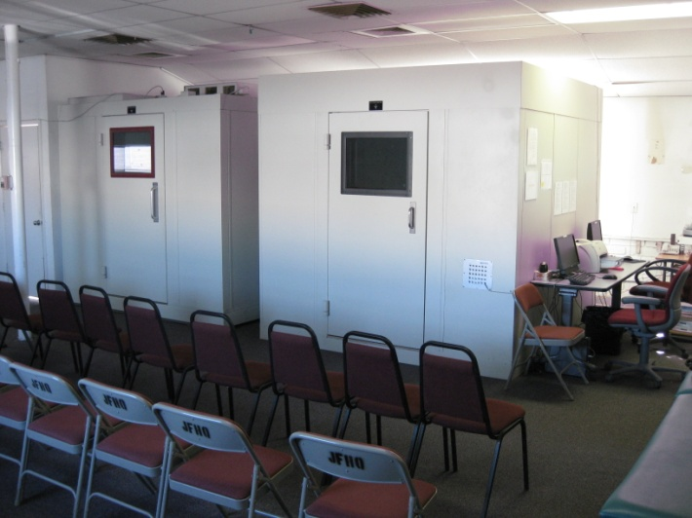
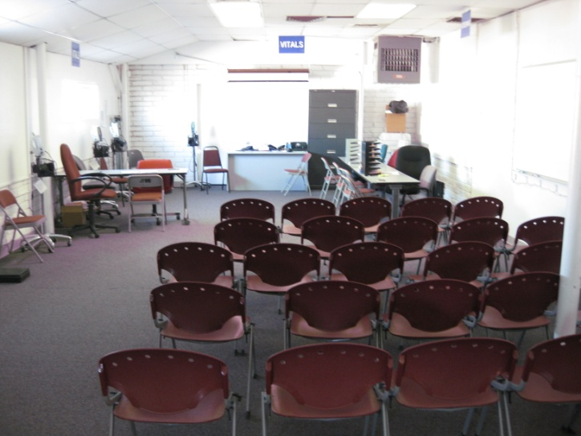
Audiometer and Test Environment
Audiometer Test Environment
Must meet standards outlined in DoDI 6055.12
If standards are not met, valid audiometric test results are not achieved
Tri-Service Hearing Technician 4.2 Certification Course

Slide 13
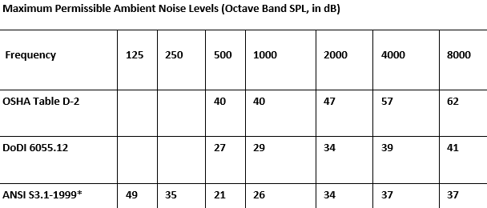
Audiometer and Test Environment
Ambient Noise Level Limits
Audiometric test environment must not exceed MPANL
For surveillance/monitoring audiometry, ambient noise level limits are specified for five octave bands
Audio Booths are not sound proof, they are sound dampening
Tri-Service Hearing Technician 4.2 Certification Course
Notes:
Sound level survey must be done annually, booth must meet standards; any booth movement (stationary or mobile – MOHCAV) requires another survey be accomplished prior to testing; ships require 2 surveys, one pier side, one underway, both of which may have restrictions with testing

Slide 14
Audiometer and Test Environment
Controlling Ambient Noise
Excessive ambient noise may increase hearing thresholds, especially at 500 Hz
  Calibrations fail at 500 Hz because lower frequencies are more difficult to attenuate
Change testing schedule
An audiometric booth is not a regulatory requirement, but it will help meet the ambient noise limit requirements
Testing in a quiet room is acceptable if the ambient noise level requirements are met
Tri-Service Hearing Technician 4.2 Certification Course
Notes:
Rooms used in place of audiometric booths must meet a sound survey at all frequency threshold levels in order to conduct accurate HCP audio testing.

Slide 15
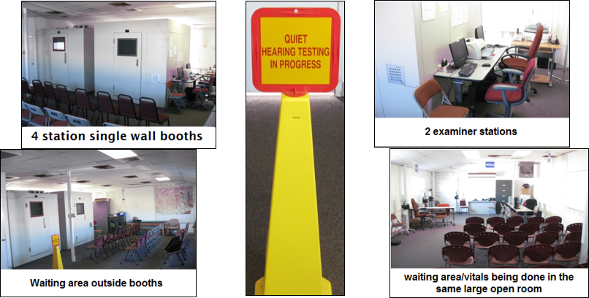
Audiometer and Test Environment
Audiometric Test Booths
Tri-Service Hearing Technician 4.2 Certification Course
Notes:
Single wall booths typically do not provide adequate noise reduction in high traffic areas; note on photos: vitals done in same room, along with a large waiting area, booth on right doesn’t close properly leaving a 1/4” gap
Photos provided by Allan White (photographer), U.S. Army Hearing Program

Slide 16
Audiometer and Test Environment
Single Wall Audiometric Test Booth versus Double Wall
Booth placement and background noise in the testing area will determine the need for a single or double wall booth
A single wall booth is usually acceptable in a quiet, low traffic location
A double wall booth will likely be required for a location where other background noise is vibrant (excessive/continuous ambient noise)
Tri-Service Hearing Technician 4.2 Certification Course
Notes:
Determine background noise levels; structural considerations - floor handle the weight of the booth, electrical outlets, heating/cooling, do not mount directly on the deck of a ship; is the room large enough for the booth, vents, examiner station and door opening; any noise related items happening near the building where testing is going on – runways, motor pool, etc.

Slide 17
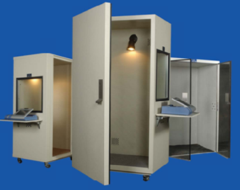
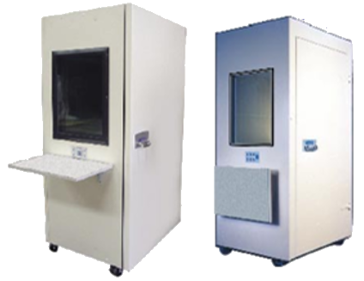
Audiometer and Test Environment
Single Wall, Single Station Booth
Tri-Service Hearing Technician 4.2 Certification Course
Notes:
There are many sound booth manufacturers; DoD does not recommend any particular brand; Single person booths advantages: mobility, updated sound level survey is required once relocated, do not require being disassembled/reassembled for the relocation, one on one examiner/listener ratio, testing accomplished quickly; booths shown are Acoustic Systems booths/ETS-Lindgren and Eckel, both have Government pricing at GSA

Slide 18
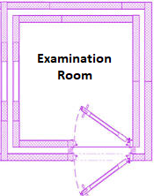
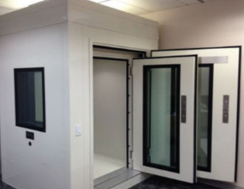
Audiometer and Test Environment
Double Wall, Single Station Booth
Tri-Service Hearing Technician 4.2 Certification Course
Notes:
Dual doors (double) could swing into the booth or outside the booth

Slide 19
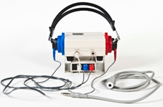
Audiometer and Test Environment
DOEHRS-HC
DOEHRS-HC is the Military Services system of record for conducting monitoring audiometry
DOEHRS-HC consists of:
  Desktop database software
  Microprocessor Audiometer hardware and software (Benson Medical Instruments CCA-200)
  Web-based data repository
All monitoring audiometry for the Military Services personnel will be recorded in DOEHRS-HC
Tri-Service Hearing Technician 4.2 Certification Course
Notes:
Review again - DOEHRS-HC consists of sub-fields (examiner information, UIC/WICs, audiometers, listeners) that are associated with multiple records and are required to be filled out correctly; current fields are individually associated with a patient record(s); Correct user/examiner required to be logged into software.

Slide 20
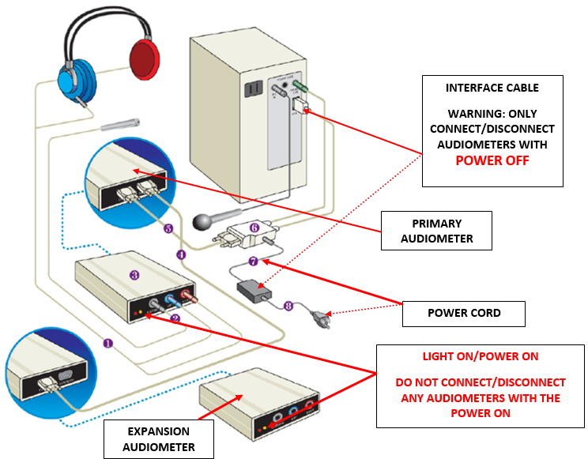
Audiometer and Test Environment
Audiometer Set-up/Connections
Notes:
Review equipment and set-up, have students confirm the headset serial number and audiometer serial number match; review the serial number for the BAS
Never separate audiometer headset from the audiometer
Never connect or disconnect the audiometer from the computer or another audiometer without ensuring the audiometer power is off

Slide 21
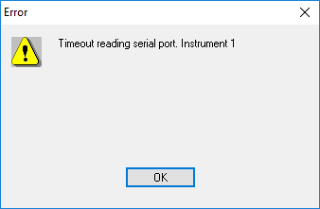
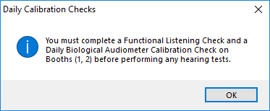
Audiometer and Test Environment
Audiometer Checks
Resolve audiometer error messages (common one is power disruption)
Visual Check
  Ensure equipment is clean
  Ensure headset wiring and response switch are untangled
  Ensure equipment is properly connected
Tri-Service Hearing Technician 4.2 Certification Course Video Next Slide
Notes:
Done daily, required prior to any audio testing, resolve any error messages prior to continuing.

Slide 22
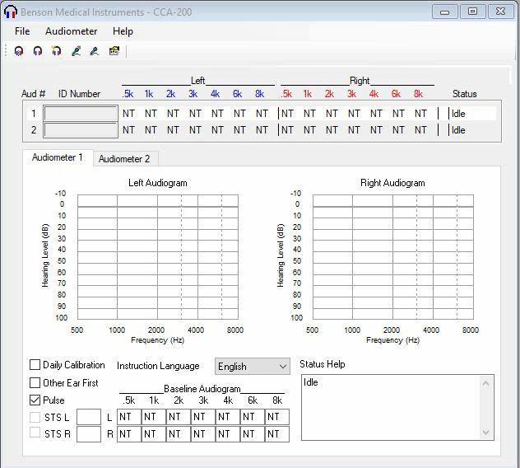
Notes:
2 minute video - Function Check, no vocals, describe what is occurring
Set software up to do a functional check; go to each audiometer to start the functional check, placing the headphones on and pressing hand switch inside booth to listen to the frequency/intensity sweep/functional check. Do not start the functional check from the computer screen.
Resolve any problems with the functional listening check prior to starting the daily biological calibration test, if it cannot pass, do not calibrate, audiometer cannot be used. Address equipment issues immediately with the hearing program manager or professional supervisor.

Slide 23
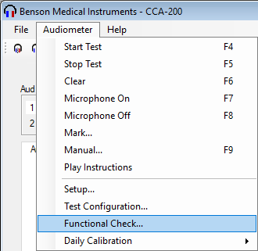
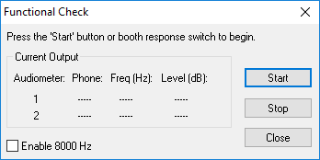
Audiometer and Test Environment
Audiometer Functional Listening Check
Technician conducting the Functional Listening Check is required to have normal hearing
Listening Check
  Frequency sweep – left ear
  Intensity sweep – right ear
  Steady 60 dB tone – Check both ears for Static/Break and Cross-talk
Ensure you go inside the booth, place the headphones on and start the functional test by pressing the response switch
Tri-Service Hearing Technician 4.2 Certification Course
Notes:
Done daily, required prior to any audio testing

Slide 24

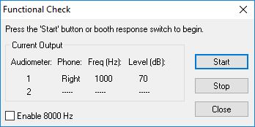
Audiometer and Test Environment
Audiometer Functional Listening Check
Place headphones on
Press the response switch once to start check
Done individually per station
Definitive separation of each tone
  Check always begins on the left ear with a 60 dB tone doing a frequency sweep 500 Hz, 1000 Hz, 2000Hz, 3000Hz, 4000 Hz, 6000 Hz
  Auto switches to right ear, intensity sweep 70 dB, 60 dB, 50 dB, 40 dB, 30 dB, 20 dB, 10 dB, 0 dB
Tri-Service Hearing Technician 4.2 Certification Course

Slide 25


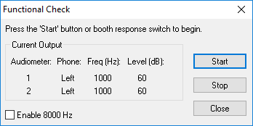
Audiometer and Test Environment
Audiometer Functional Listening Check
Auto switches to a steady 60 dB tone in left ear
  Check for static/breaks
  Check for cross-talk
Press the response switch once to change the tone to the right ear
  Check for static/breaks
  Check for cross-talk
Repeat if needed
Have all students perform the function check, identify any problems (Function Check video next slide)
Tri-Service Hearing Technician 4.2 Certification Course

Slide 26
Audiometer and Test Environment
Daily Biological Calibration Check
Use the BAS-200 (artificial ear) to establish a primary and secondary baseline (different listener) after annual electro-acoustic calibration
Secondary baseline is used if the primarily listener becomes inoperative
The baseline is recorded on DD Form 2217
Ensure BAS-200 is activated and properly connected to audiometer
Daily calibration thresholds are compared to the calibration baseline on the DD Form 2217
Tri-Service Hearing Technician 4.2 Certification Course
Notes:
Done daily, required prior to any audio testing

Slide 27
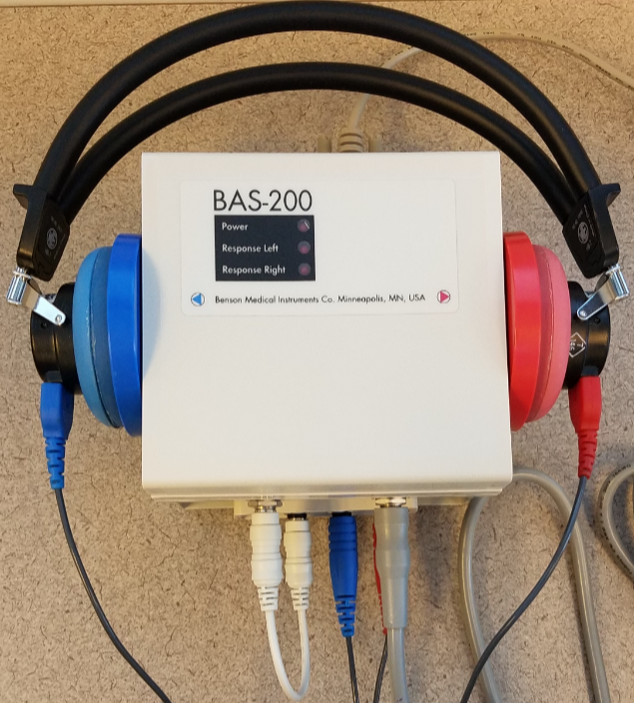
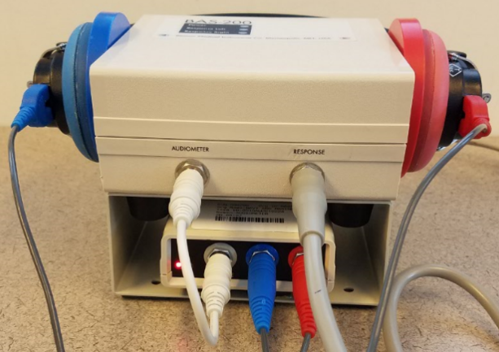
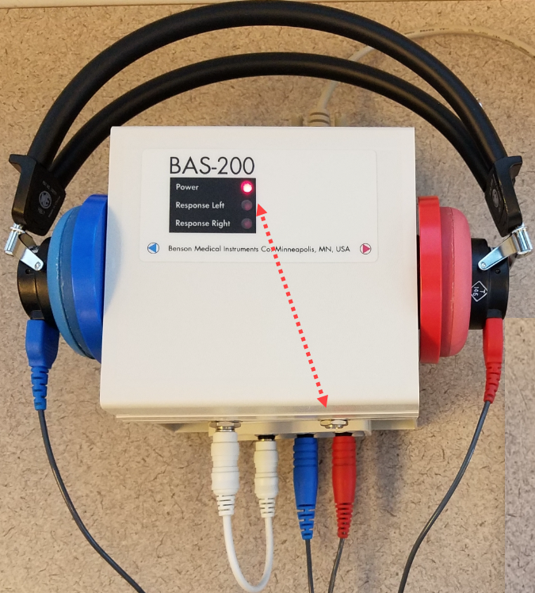
Audiometer and Test Environment
Daily Biological Calibration Check Hardware Set-up
Ensure headset are properly placed on the BAS
  Headband parallel to the face of the BAS-200
  Headband yolk completely compressed
Remove response switch from BAS-200 to activate the BAS for the calibration test
Completely close the audio booth door prior to starting any tests
Notes:
Done daily, required prior to any audio testing

Slide 28
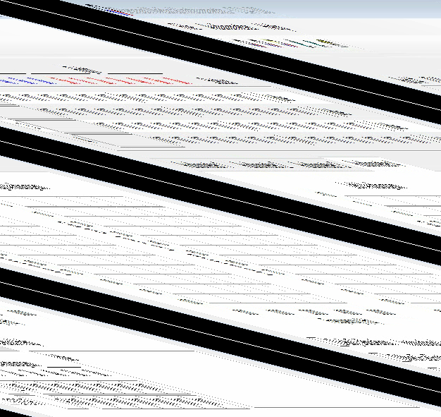
Notes:
94 second video, setting software up and conducting calibrations

Slide 29
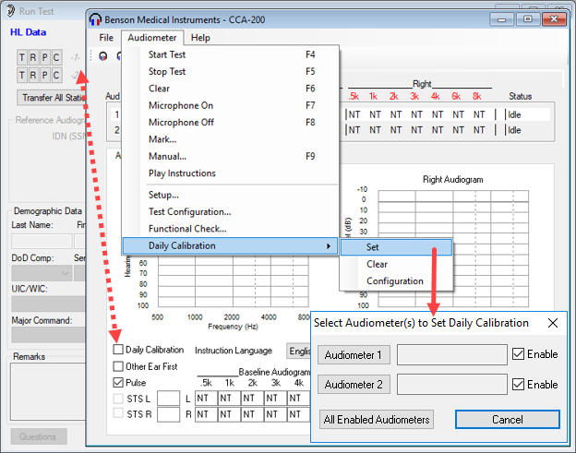
Audiometer and Test Environment
Daily Biological Calibration Check Software Set-up
Booth numbers are italic (calibration not done)
Audiometer > Daily Calibration > Set
Set daily calibration test for all audiometers
Tri-Service Hearing Technician 4.2 Certification Course
Notes:
Calibration required daily, prior to any audio testing

Slide 30
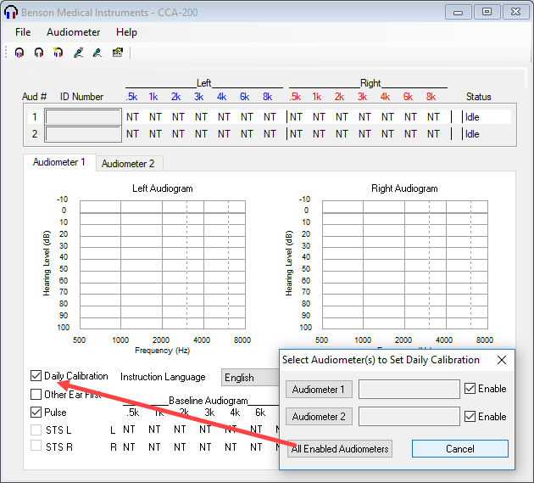
Audiometer and Test Environment
Daily Biological Calibration Check Software Set-up
Press all enabled audiometers
Daily calibration test will be set for all audiometers
Tri-Service Hearing Technician 4.2 Certification Course

Slide 31
Audiometer and Test Environment
Establishing Calibration Baselines
Have students run calibrations (first time)
Write down (page 44) or do a screen shot of the calibration results (CCA-200 window)
Change the testing parameters
  Remove/Replace the headset on the BAS
  Unplug and re-insert left and right headset plugs in BAS
  Unplug and re-insert patch cord from BAS and audiometer
Do not retrieve results in the listener window
Cancel and re-run calibration test
Calibration video next side with adding listener and audiometer
Tri-Service Hearing Technician 4.2 Certification Course Video Next Slide
Notes:
Write results down on page 46

Slide 32
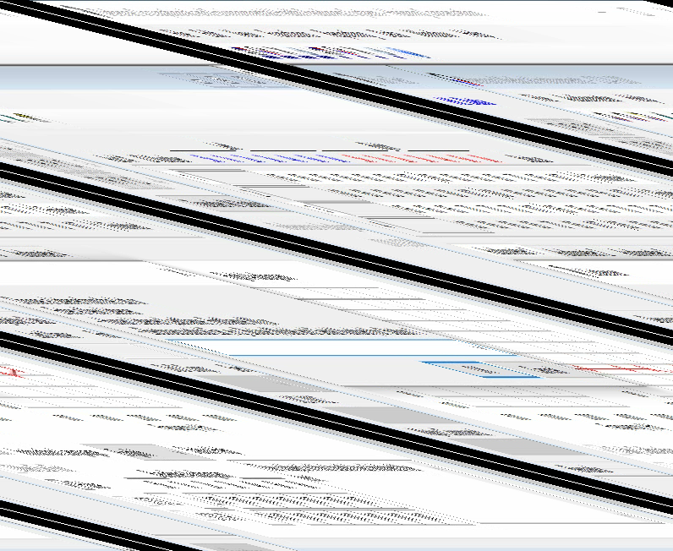
Notes:
91 second video retrieving results, creating/saving calibration listener and audiometer

Slide 33
Audiometer and Test Environment
Establishing Calibration Baselines
Re-run calibration test
Compare results with those received from the initial calibration
  Look for consistency in threshold results
  Results plus or minus 5 dB for 500 Hz thru 4000 Hz
  Results plus or minus 10 dB for 6000 Hz
If the thresholds are the same or mimicking above passing criteria of the initial calibration results, retrieve results as baseline
Conduct again if not “successful” until consistent results are achieved
Tri-Service Hearing Technician 4.2 Certification Course
Notes:
Have students whose results are not “successful” raise their hands, have a facilitator check/compare their results

Slide 34
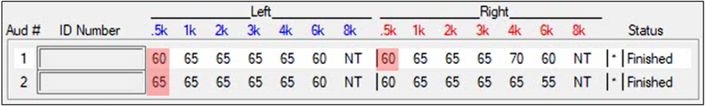
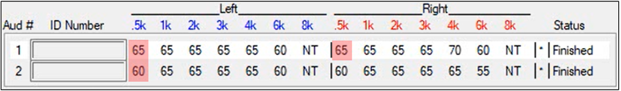
Audiometer and Test Environment
Establishing Calibration Baselines
Initial baseline (threshold not retrieved)
Baselines received after changing testing parameters
Retrieve results if consistent
Tri-Service Hearing Technician 4.2 Certification Course
Notes:
Have students whose results are not “successful” raise their hands, have a facilitator check/compare their results

Slide 35
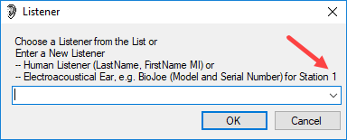
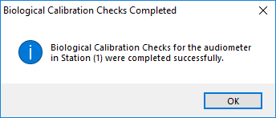
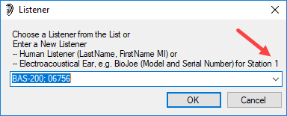
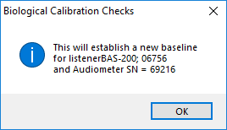
Audiometer and Test Environment
Adding a Calibration Listener
Calibrations may not be completed in sequential order, check the station number prior to entering the BAS serial number
Enter listener as BAS-200 and add BAS serial number
Have student add listener (example: BAS-200; #####)
Tri-Service Hearing Technician 4.2 Certification Course
Notes:
All listeners serial number should start with a 0 or 1

Slide 36
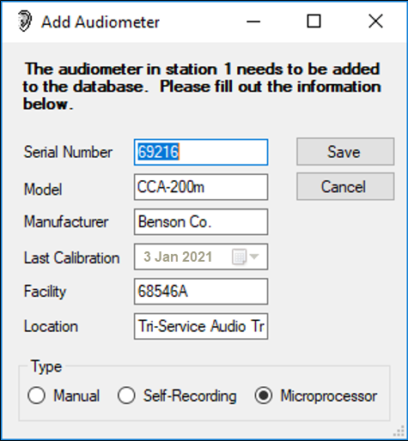
Audiometer and Test Environment
Adding Calibration Audiometer
Application will auto fill audiometer information from the Benson Medical window and sub-fields previously filled out
  Audiometer serial number, make and model
  Electro-acoustic calibration date
  Facility/Location
  Audiometer type
  Ensure you tab through the fields prior to saving
Manual/Microprocessor selection
  Defaults to Microprocessor
Have students save audiometer
Tri-Service Hearing Technician 4.2 Certification Course
Notes:
Failure to tab through fields may leave facility/location blank on the DD Form 2217 and with the saved audiometer.
Review with students who uses the manual audiometer and who uses the microprocessor

Slide 37
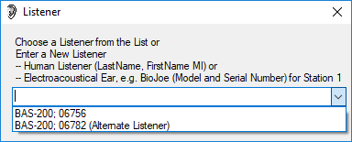

Audiometer and Test Environment
Daily Calibration Listeners
Once listeners and audiometers are added a calibration baseline is created on DD Form 2217
Select the correct listener from the drop down window for daily comparison with the baseline
Alternate baselines should be established when the primary listener is created (used if primary listener becomes inoperative)
Tri-Service Hearing Technician 4.2 Certification Course
Notes:
The functional check and daily calibration must be completed successfully and retrieved into the DOEHRS-HC software daily in order to perform any hearing tests

Slide 38
Audiometer and Test Environment
Successful Equipment Tips
Resolve any problems with the functional listening check prior to starting the daily calibration test
Follow the same calibration procedures every time the procedure is completed
Have an alternate listener baseline already conducted in case the primary listener becomes inoperative
Address equipment issues immediately with the hearing program manager or professional supervisor
Tri-Service Hearing Technician 4.2 Certification Course

Slide 39
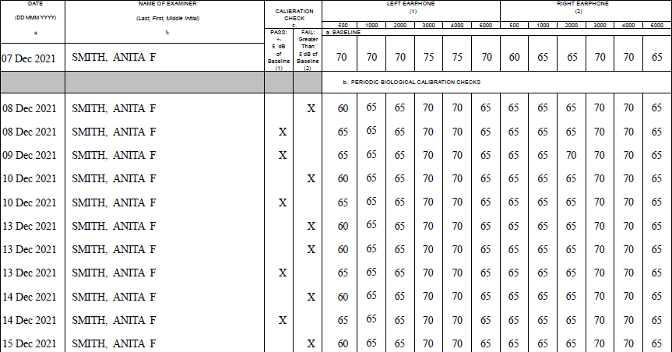
Audiometer and Test Environment
Invalid Calibration Baseline Established
Notes:
Students can view this DD Form 2217 in DOEHRS-HC, select date range December 2021, look at serial number 71544
Issues with invalid calibration baselines should be identified very soon after they are established. What is the problem with the baseline? Left ear, specifically 500 Hz but all frequencies are off by 5 decibels.

Slide 40
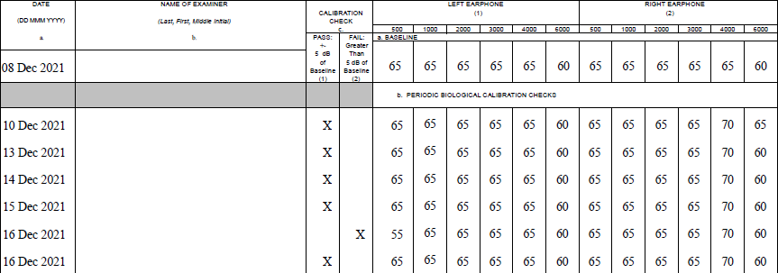
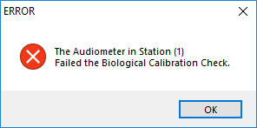
Audiometer and Test Environment
Invalid Calibration Baseline Established
Notes:
Students can view this DD Form 2217 in DOEHRS-HC, select date range December 2021, look at serial number 69663
Issues with failed daily calibration baselines; technician should reset headset, clean/re-insert RCA plugs, re-run calibrations. What frequency failed? (left ear, 500 Hz)

Slide 41
Audiometer and Test Environment
Audiometer/BAS-200 Common Problems
Headphone placement
  Place headband on BAS parallel to wall
  Completely tighten headband yolk
  Loosen headband to remove from BAS
Review DD Form 2217 for unsuccessful daily calibrations
Invalid baseline established
If function check/daily calibration is not completed and/or is not successful, audiometer cannot be used for testing
Tri-Service Hearing Technician 4.2 Certification Course

Slide 42
Audiometer and Test Environment
DD Form 2217
Stored in DOEHRS-HC
Print or export/save DD Form 2217 monthly
Maintain copy of each DD Form 2217 for 5 years
Tri-Service Hearing Technician 4.2 Certification Course

Slide 43
Audiometer and Test Environment
Summary
Audiometer types: microprocessor/manual audiometers
  Advantages/Disadvantages
Audio booth/certification
Equipment set up/connections
Function Check
Establishing calibration baselines
  Adding BAS listener/audiometer
  Unsuccessful checks
Audiometer calibrations annual/daily/DD Form 2217
Common BAS and audiometer issues, troubleshooting
Tri-Service Hearing Technician 4.2.0.0 Certification Course

Slide 44
Audiometer and Test Environment
? Questions ?
Tri-Service Hearing Technician
4.2 Certification Course

